Slide 1
Assessing Learning Outcomes
“Closing the Loop”

Slide 2
A Quick Review
Learning Outcome
the goal or objective for the student; what the student should be able to do at the end of the instruction
Benchmark
the standard of student learning we want to achieve
Assessment
the process to measure effectiveness
Assessment Tool
The instrument used to measure student learning: quiz, essay, activity, etc.
Learning Outcome Assessment
process to measure the effectiveness of the learning
Did we achieve our goal? Did students meet the benchmark?

Slide 3
Why do we assess learning outcomes?
To improve student learning

Slide 4
The Assessment Cycle
Set learning objectives & benchmarks
Select assessment tool
Teach
Gather & analyze data to assess effectiveness
Make revisions

Slide 5
The Syllabus Alignment Chart
Set learning objectives & benchmarks
Select assessment tool
Show how learning objectives support program/division/degree outcomes
Identify whether the objective introduces, reinforces or emphasizes material
Show how the objectives support GFCMSU’s College Learning Outcomes

Slide 6
Course Objective | Aligns with which program, division, or/degree outcome* | Type of Course Objective: Introductory, Reinforce, or Emphasize | Assessment tool used to determine if Learning Objective has been met or achieved | MSU-Great Falls Abilities
Manipulate Real and Complex Numbers | Use arithmetic, algebraic, geometric, technological, or statistical methods to solve problems | Reinforce | 75% of students will achieve a score of 70% or higher on Chapter 3 Test. | CLO 3
Manipulate polynomial, rational, radical, exponential, and logarithmic functions of a real variable | Use arithmetic, algebraic, geometric, technological, or statistical methods to solve problems | Reinforce | 75% of students will achieve a score of 70% or higher on exams covering Chapters 3, 4, and 5 | CLO 3
Graph polynomial, rational, radical, exponential, and logarithmic functions of a real variable | Represent mathematical concepts verbally, and where appropriate, symbolically, visually, and numerically. | Reinforce | 75% of students will achieve a score of 70% or higher on exams covering Chapters 3, 4, and 5 | CLO 3
Find inverse functions for selected polynomial, rational, radical, exponential, and logarithmic functions of a real variable | Use arithmetic, algebraic, geometric, technological, or statistical methods to solve problems | Reinforce | 75% of students will achieve a score of 70% or higher on Chapter 5 Test | CLO 3
Use polynomial, rational, radical, exponential, and logarithmic functions of a real variable to model real-world phenomena and solve applied problems | Represent mathematical concepts verbally, and where appropriate, symbolically, visually, and numerically Recognize and use connections within mathematics and between mathematics and other disciplines | Reinforce | 75% of students will achieve a score of 70% or higher on exams covering Chapters 1, 2, 3, 4, and 5 | CLO 3

Slide 7
GFCMSU’s College Learning Outcomes
All graduates will engage in learning activities that enhance their professional and personal lives, as well as their communities. During their academic careers at Great Falls College Montana State University, students will engage in learning activities that demonstrate:
CLO 1 – Effective Communication: The active expression and exchange of ideas through listening, speaking, reading, writing or other modes of non-verbal or artistic expression.
CLO 2 – Technical Literacy: The ability to form strategies to locate, evaluate, and apply information, and know the ethical issues surrounding information and technology.
CLO 3 – Critical Thinking and Quantitative Reasoning: The ability to analyze data, arguments, assumptions, and problems in order to draw conclusions.
CLO 4 – Workforce Readiness: The ability to exercise the skills, competencies and behaviors necessary to succeed in the workplace or at a transfer institution.
CLO 5 – Citizenship: The ability to apply the knowledge, skills and values individuals utilize to be effective, active citizens.

Slide 8
Course Objectives Assessment: The Learning Outcomes Assessment Form (Phase IV)
Gather & analyze data to assess effectiveness
Make revisions

Slide 10
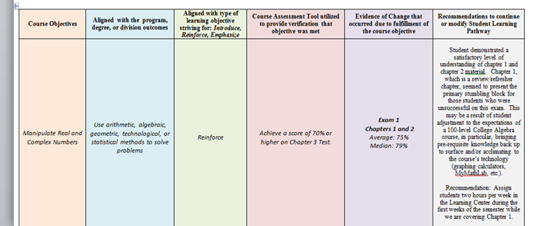
The first four columns come from the syllabus.

Slide 11
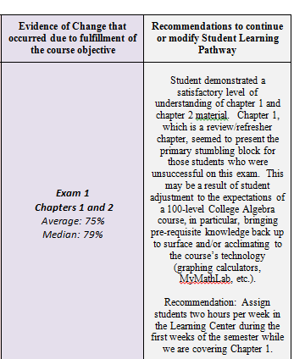
Did the students meet the benchmark?
What do I want to change?

Slide 12
Due Date
The Learning Outcomes Assessment Form is due to the Administrative Assistant the same day final grades are due to the Registrar.

Slide 13
Questions?

